Slide 1
Project 1 (P383)
Churn probability

Slide 2
Group - 4
Harish Pansari
Ankur Sharma
Subham Chauhan

Slide 3
Business Objective
Customer churn is a big problem for telecommunications companies. Indeed, their annual churn rates are usually higher than 10%. For that reason, they develop strategies to keep as many clients as possible. This is a classification project since the variable to be predicted is binary (churn or loyal customer). The goal here is to model churn probability, conditioned on the customer features.

Slide 4
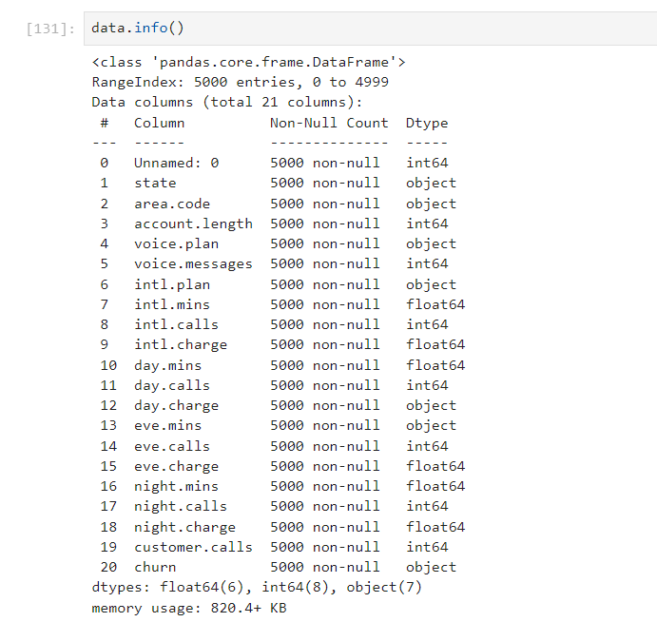
EDA Finding the Data type and Missing value

Slide 5
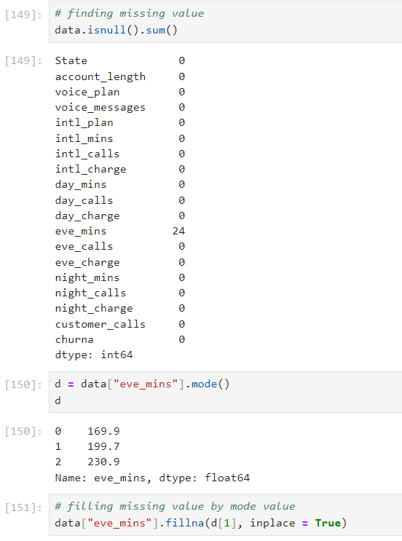
Filling the Missing Value

Slide 6
TARGET
Churn is our target variable. It is the one on that determines weather
the client is still in the company or not. (1-Churn, 0-No Churn)

Slide 7
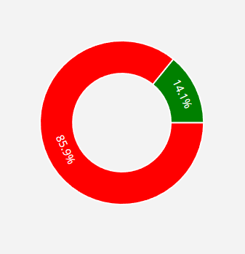
Inference from Pie Cart
There is a churn of 14.1% and
Loyal customer percentage is around 85.9%
Customer 5000

Slide 8
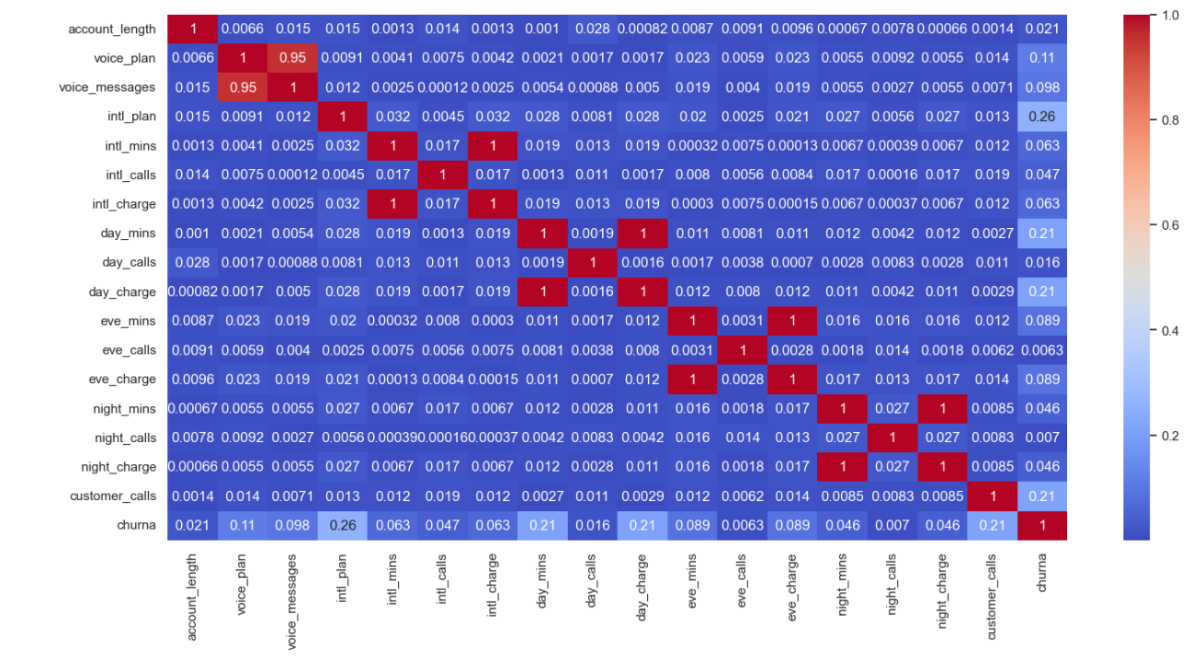
Below are few High Correlation features when compared with CHURN
customer_service_calls 0.208750
international_plan 0.259852
day_charge 0.205151
total_charge 0.231549
Weak Correlation
evening_calls 0.009233

Slide 9
Feature
Engineering
Using
Correlation

Slide 10
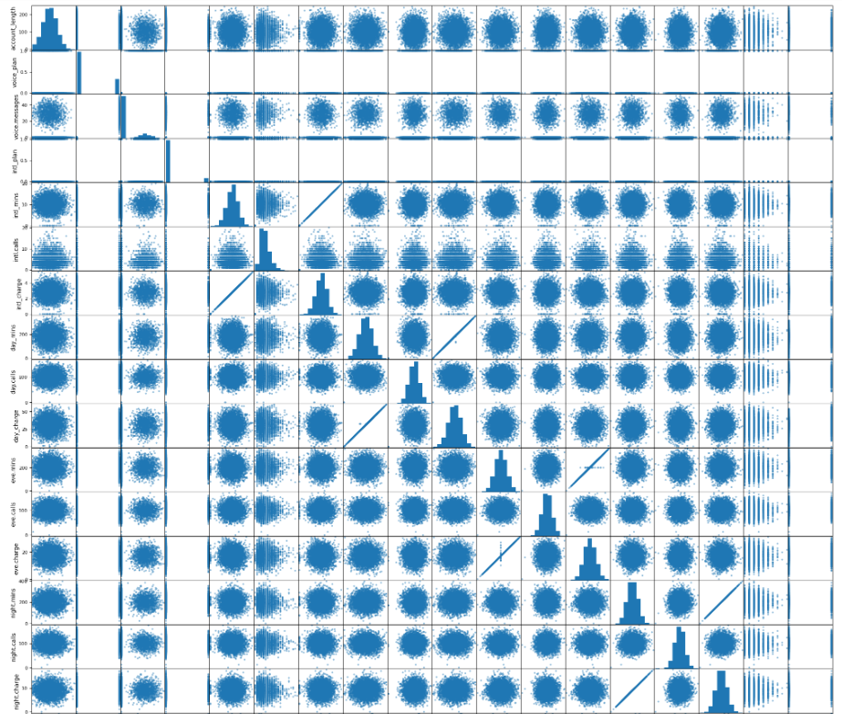
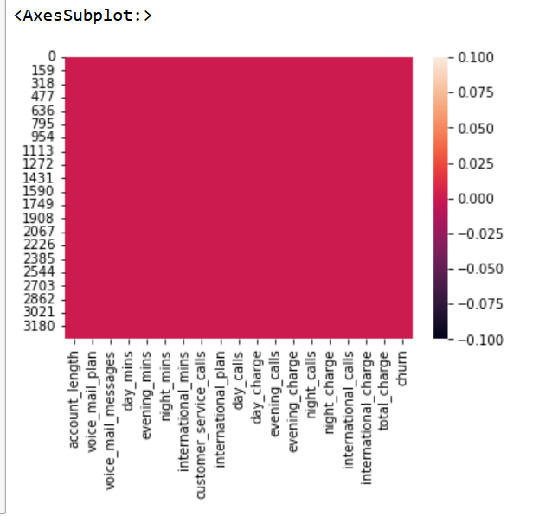
Inference from Pair plot

Slide 11
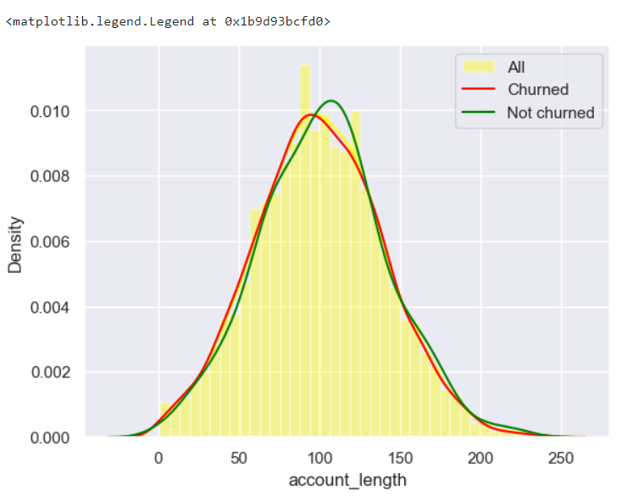
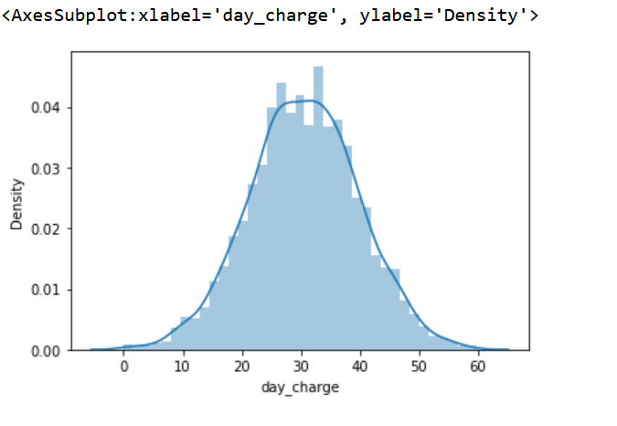
Inference from Distplot
Among all the features
Account_length and Day_charge look like normally distributed

Slide 12
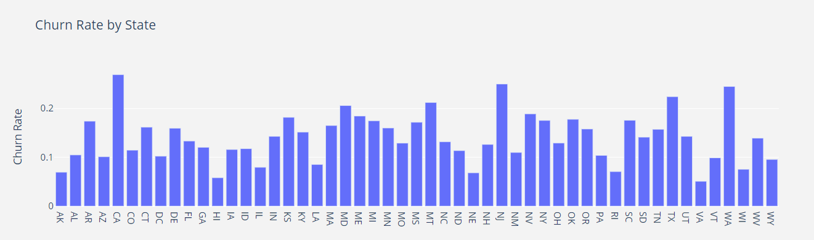
Churn By State Wise

Slide 13
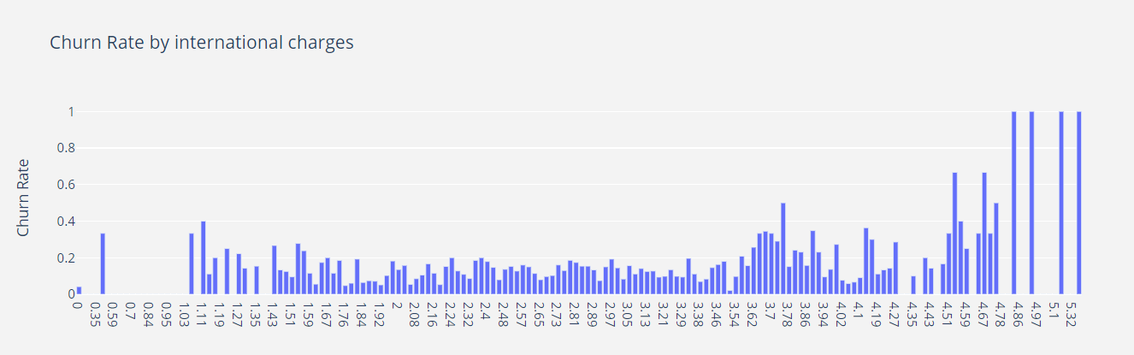
Churn by International Charges

Slide 14
Agenda 2
–
Model Building

Slide 15

Model 1 - Logistic Regression
Using Logistic Regression with
Train and Split method
Accuracy = (1057+21)/(1057+19+153+21)*100
Accuracy is 86.24%

Slide 16
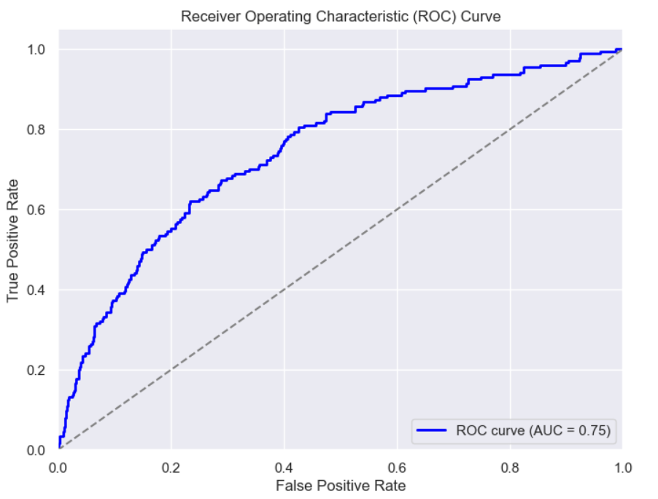
Model 1
Logistic Regression
ROC Curve

Slide 17

Model 2 - K-Nearest Neighbors Algorithm(KNN)
Using KNN with Train and Split method
Accuracy = (849+45)/(849+12+94+45)*100
Accuracy is 89.40%

Slide 18

Model 3 - Random Forest Algorithm
Using Random Forest
with Train and Split method
Accuracy = (855+101)/(855+6+38+101)*100
Accuracy is 95.60%

Slide 19

Model 4 - Support Vector Machine Algorithm (SVM)
Using SVM with Train and Split method
Accuracy = (861+0)/(861+0+139+0)*100
Accuracy is 86.10%

Slide 20

Model 5 - Naive Bayes(NB) Algorithm
Using NB with Train and Split method
Accuracy = (841+31)/(841+20+108+31)*100
Accuracy is 87.20%

Slide 21

Model 6 - XGBoost Algorithm
Using XGBoost with
Train and Split method
Accuracy = (854+112)/(854+7+27+112)*100
Accuracy is 96.60%

Slide 22
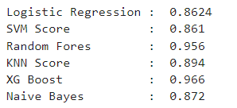
Comparing the Accuracy of all the Models
XG Boost is at best – 96.60%
But we used Random Forest = 95.60%

Slide 23
HOW TO REDUCE CUSTOMER CHURN
Lean into your best customers.
Be proactive with communication.
Define a roadmap for your new customers.
Offer incentives.
Ask for feedback often.
Analyze churn when it happens.
Stay competitive

Slide 24
CONCLUSION
The importance of this type of research in the telecom market is to help companies make more profit.
It has become known that predicting churn is one of the most important sources of income to Telecom companies.
Hence, this research aimed to build a system that predicts the churn of customers telecom company.

Slide 25
Agenda 3
–
Model Pipeline and Deployment Using Streamlit

Slide 26
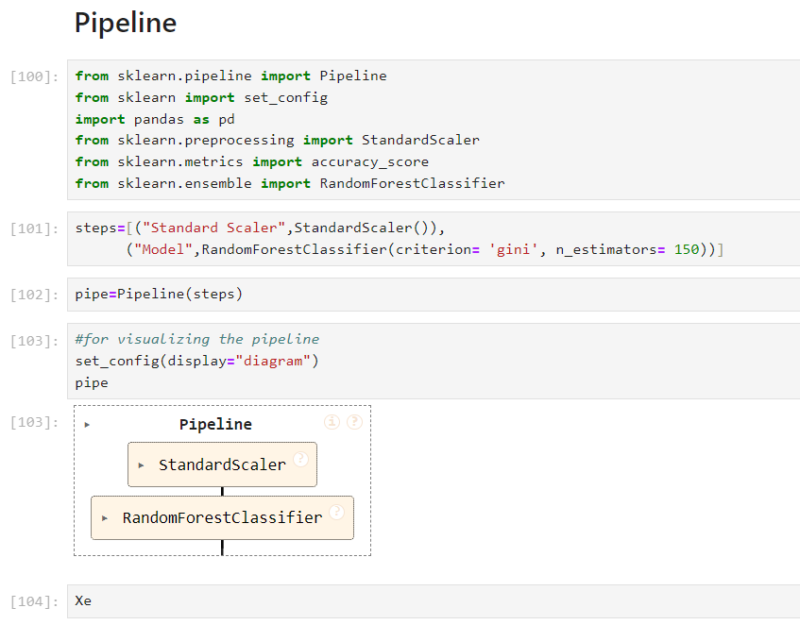
Random Forest Classifier Pipeline
Pipeline StandardScaler and Random Forest

Slide 27
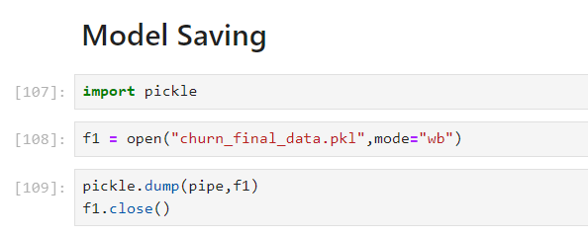
Saving the Model using Pickel
Random Forest Model Saved as
Churn_Final_Model.pkl

Slide 28
As per the Accuracy Chart below, We have finalized Random Forest Classifier and Deploying the Model

Slide 29
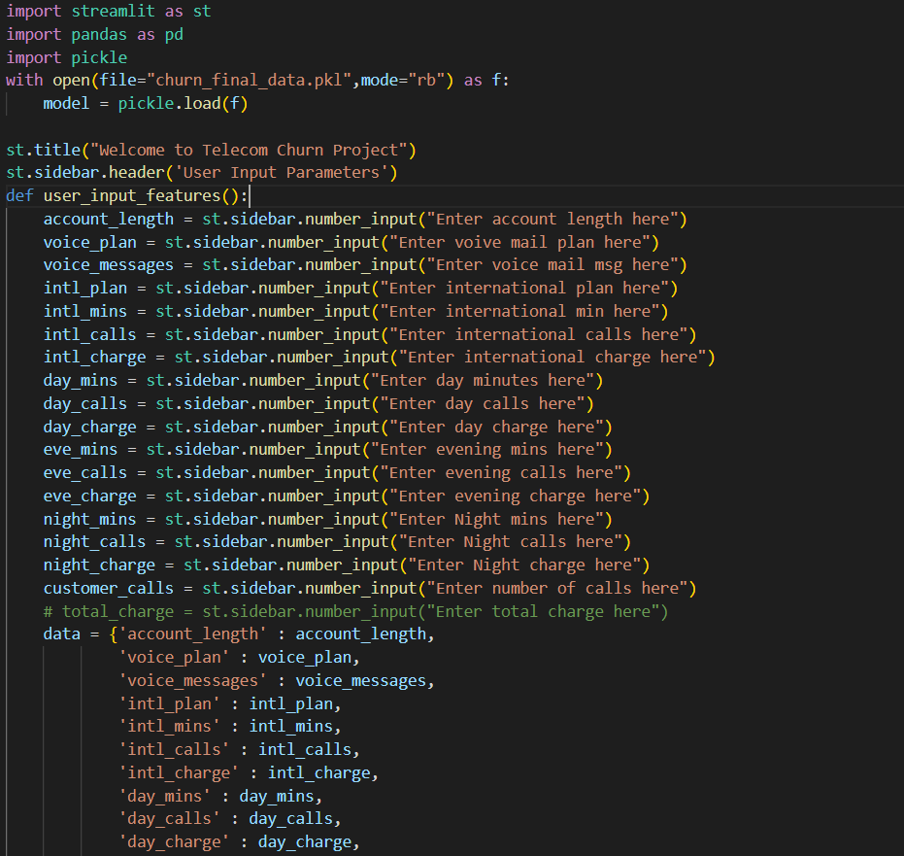
PY File Creation Using Spyder (Python 3.9)
We have created the PY file where we are calling the saved model and the input variables and Predicting based on the User Inputs.

Slide 30
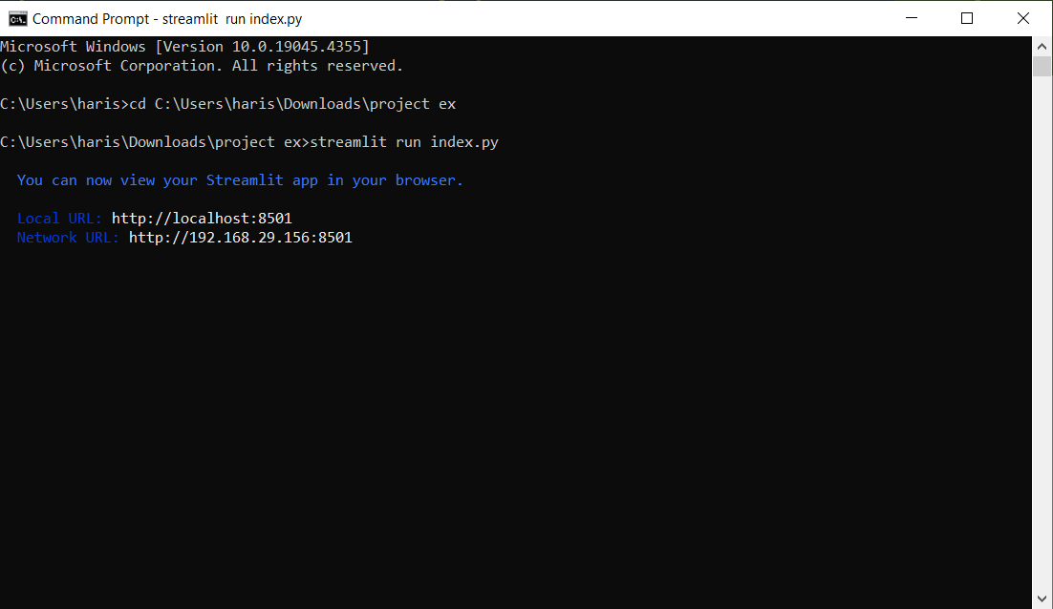
Running the PY file through Anaconda Prompt

Slide 31
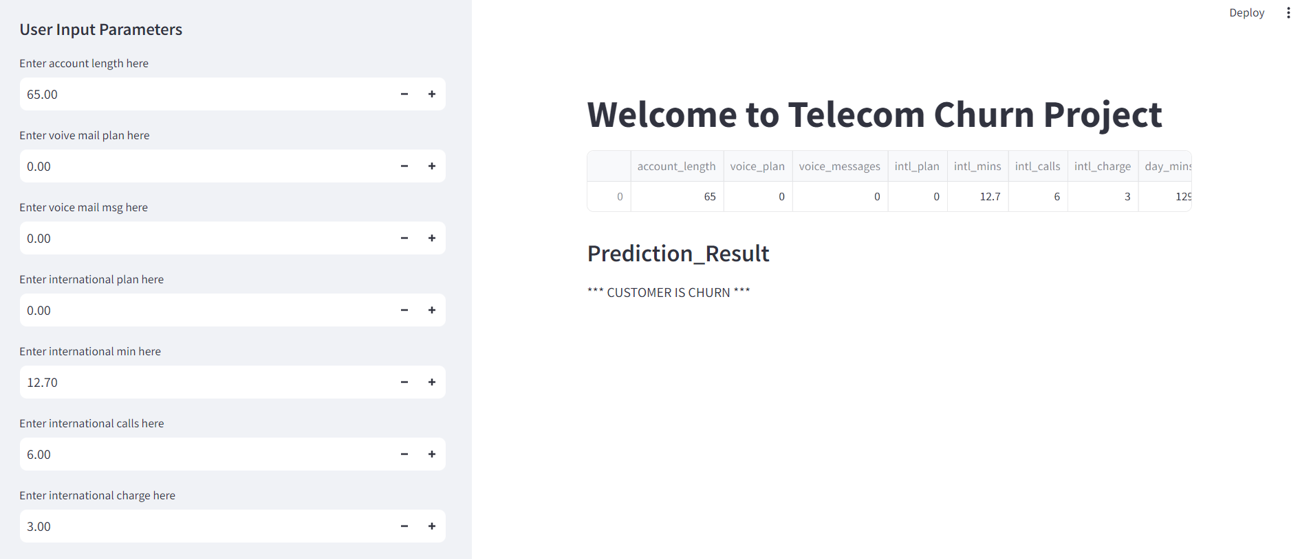
FINAL DEPLOYED MODEL
With Input Variables on left and Predictions and Probability on right

Slide 32
FINAL INFERENCE
Looking at the Model built we could see that
customer_service_calls
total_charge
were largely impacting on the CHURN Probability, hence if Telecommunications companies are monitoring the High Value (total_charge) customers and resolving the issues when they are reaching out to customer service, they can manage the CHURN rate in a controlled manner.

Slide 33


